Slide 1
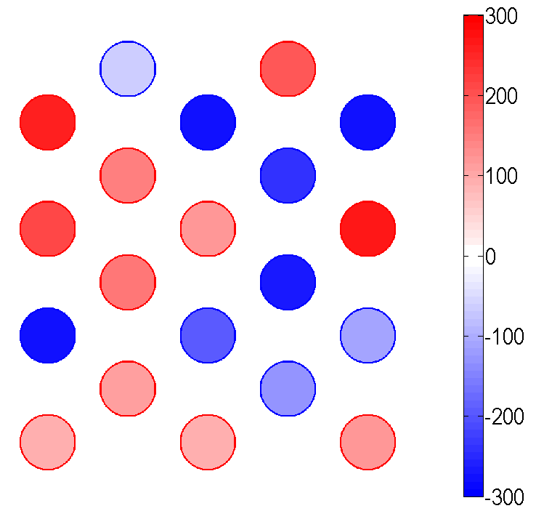
8
16
4
12
20
7
15
3
11
19
6
14
2
10
18
5
13
1
9
17

Slide 3
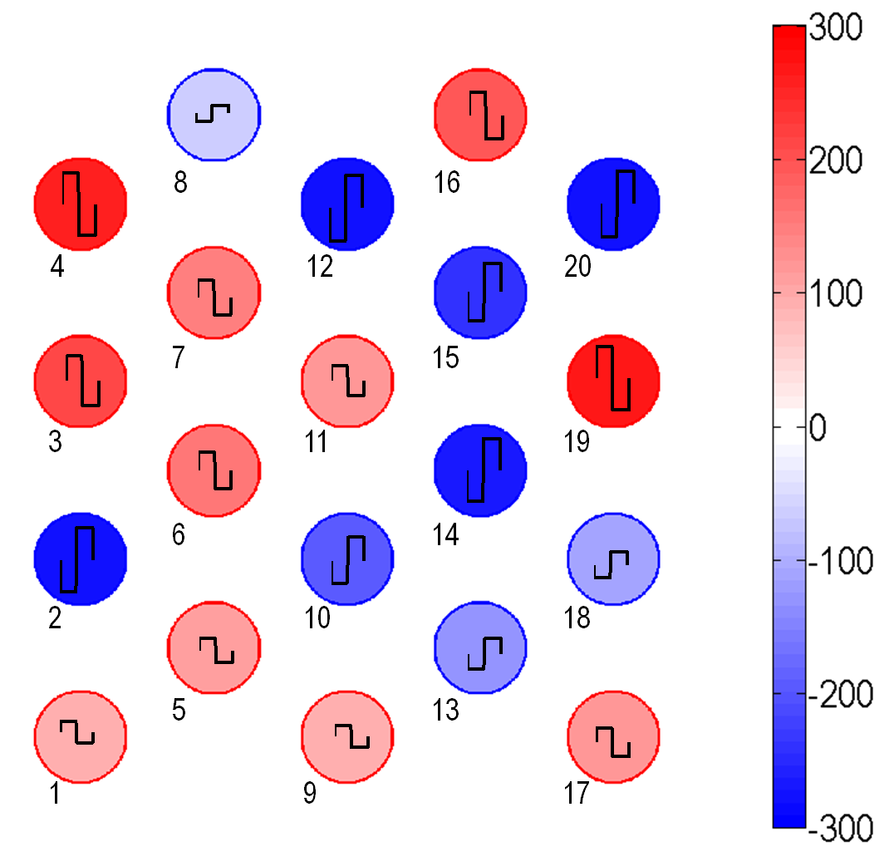
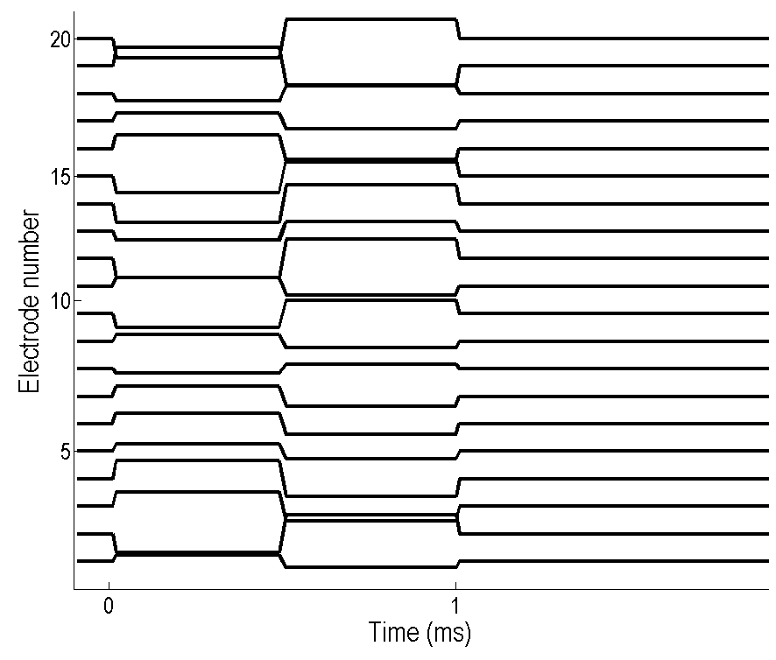
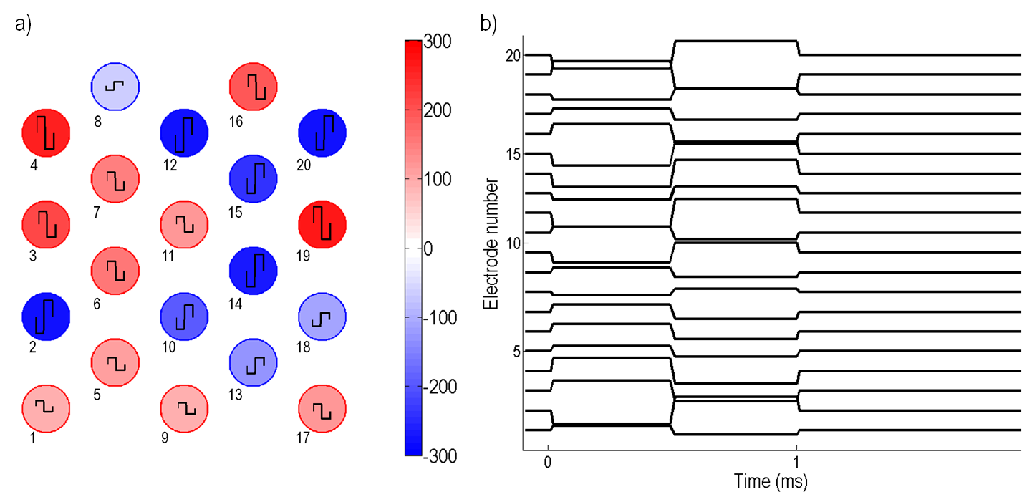
a)
b)

Slide 4
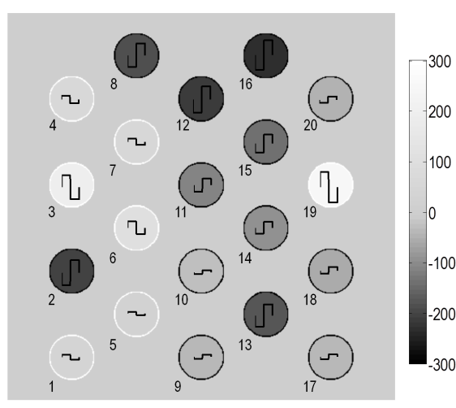
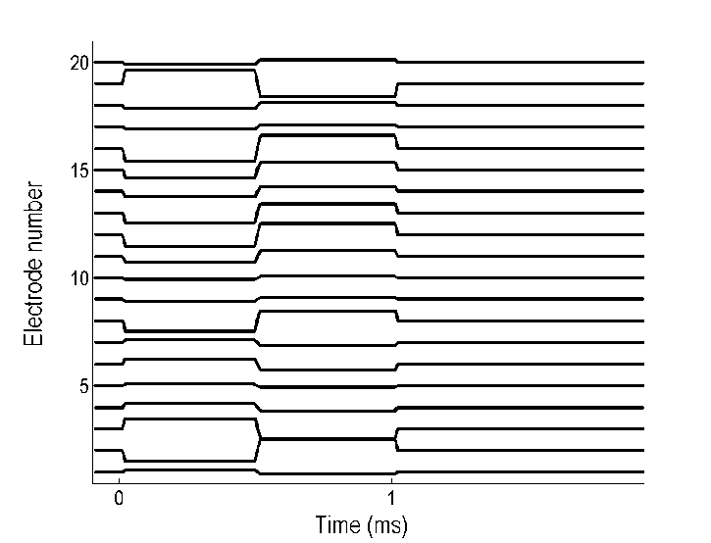
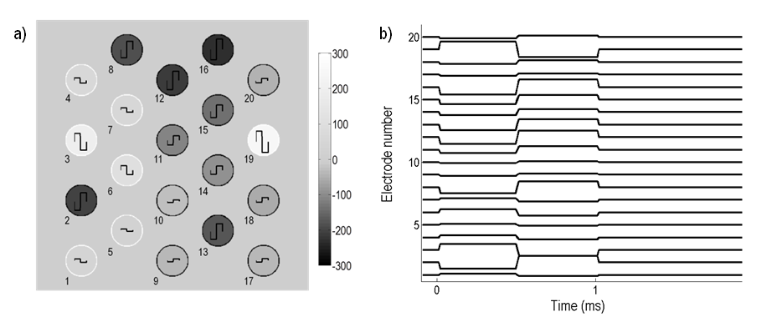
a)
b)

Slide 5
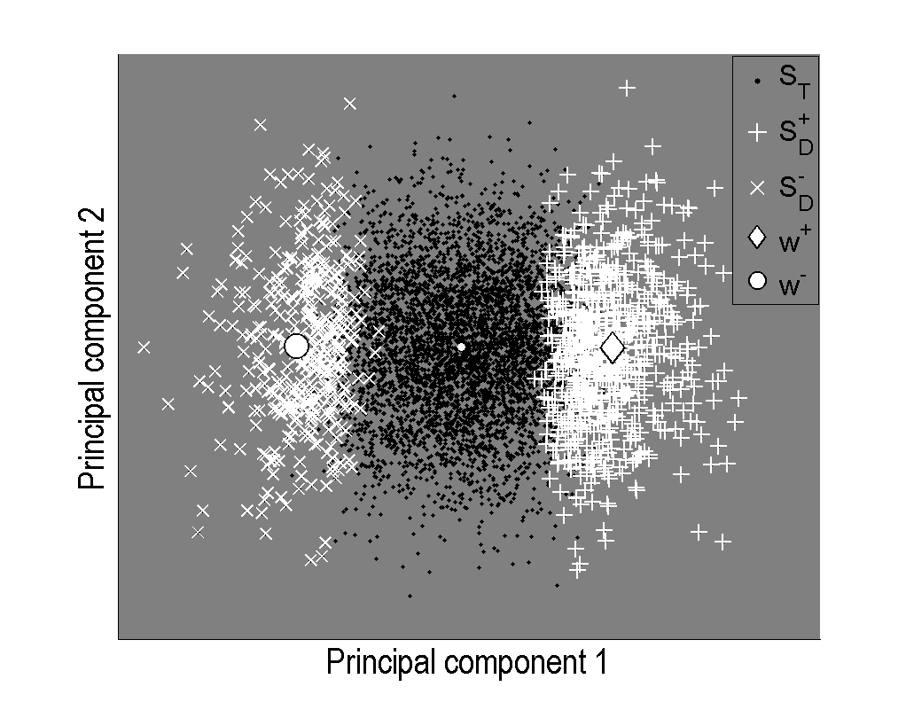
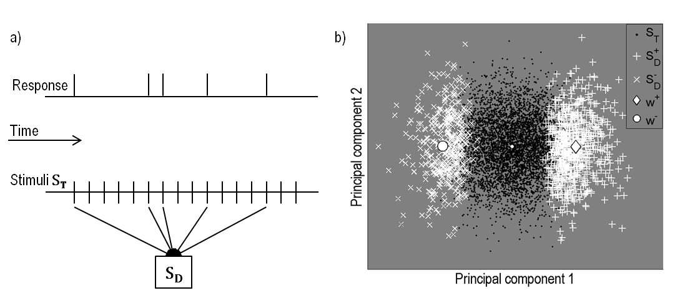
a)
b)
Response
Time
Stimuli S_{T}
S_{D}

Slide 6
Notes:
Sept 08 c2: LL responses [3.82 – 6.22 ms].

Slide 7
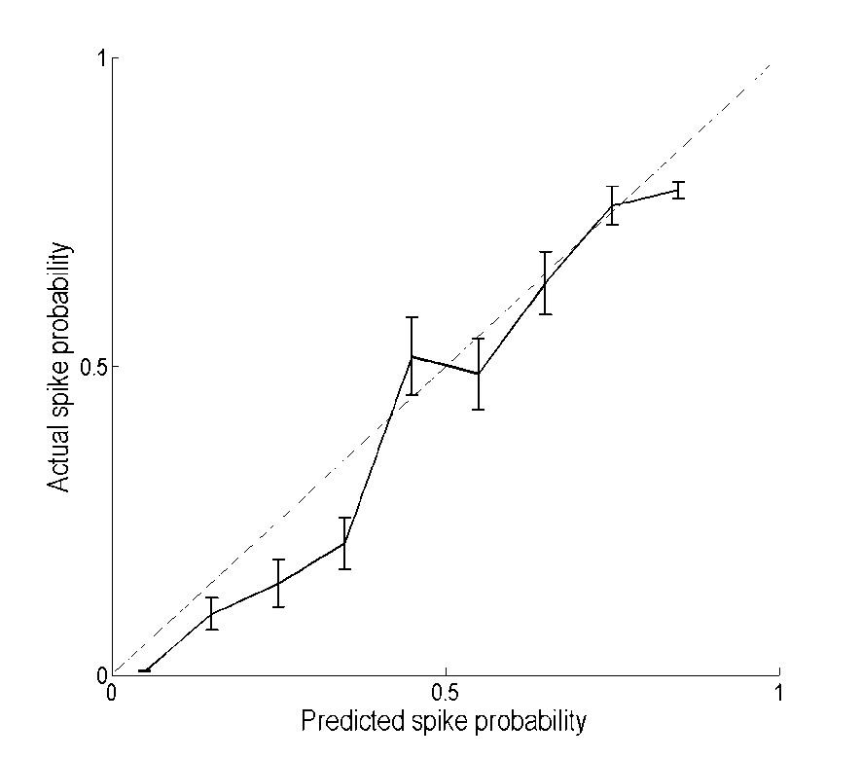
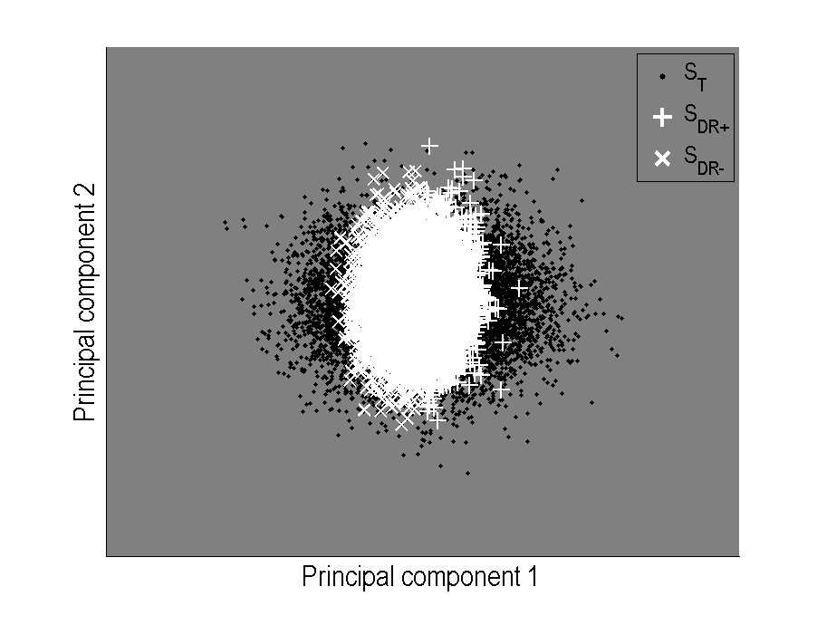
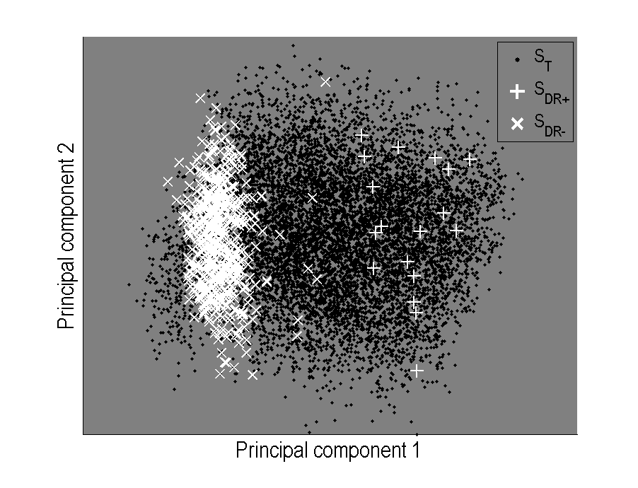
a)
b)
c)
d)
Notes:
Negative spikes (Sep30_c2)
Inhibitory response (Sep20_c2)

Slide 8
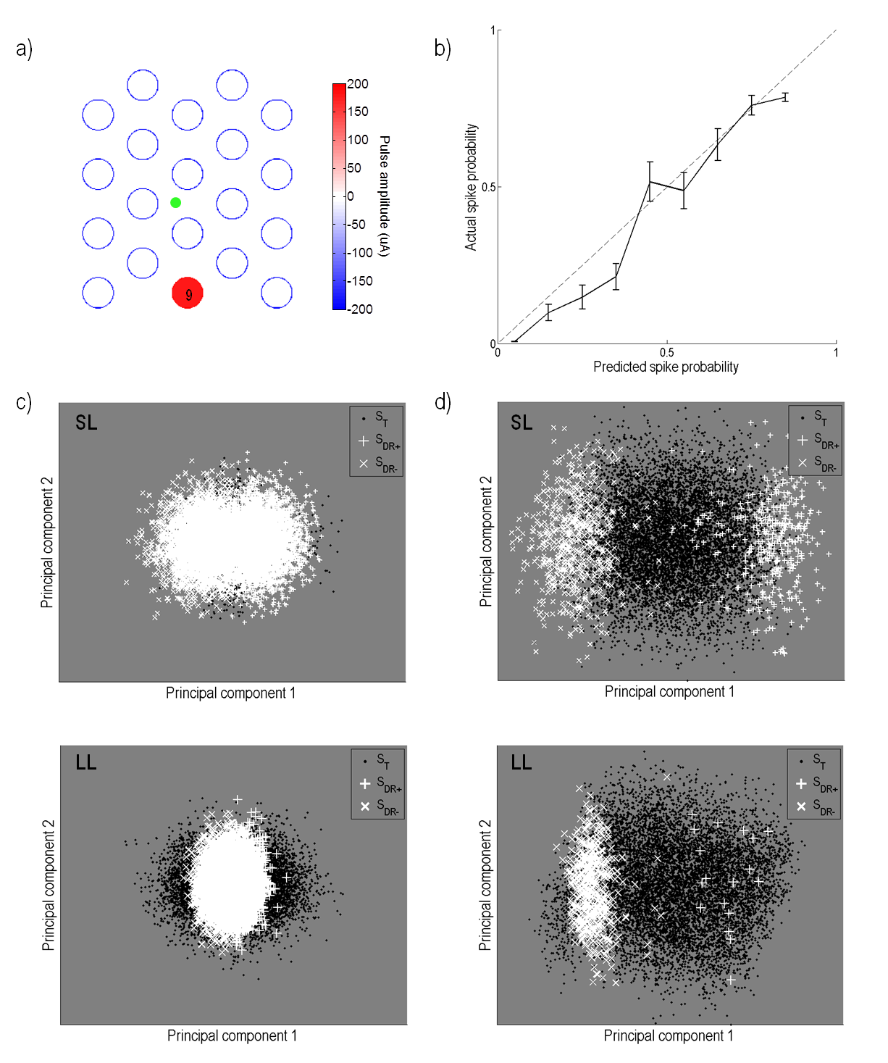
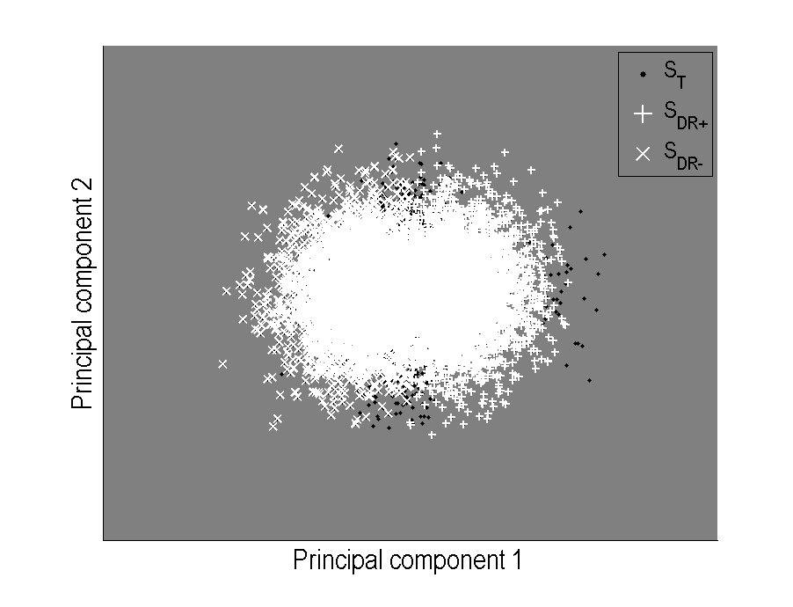
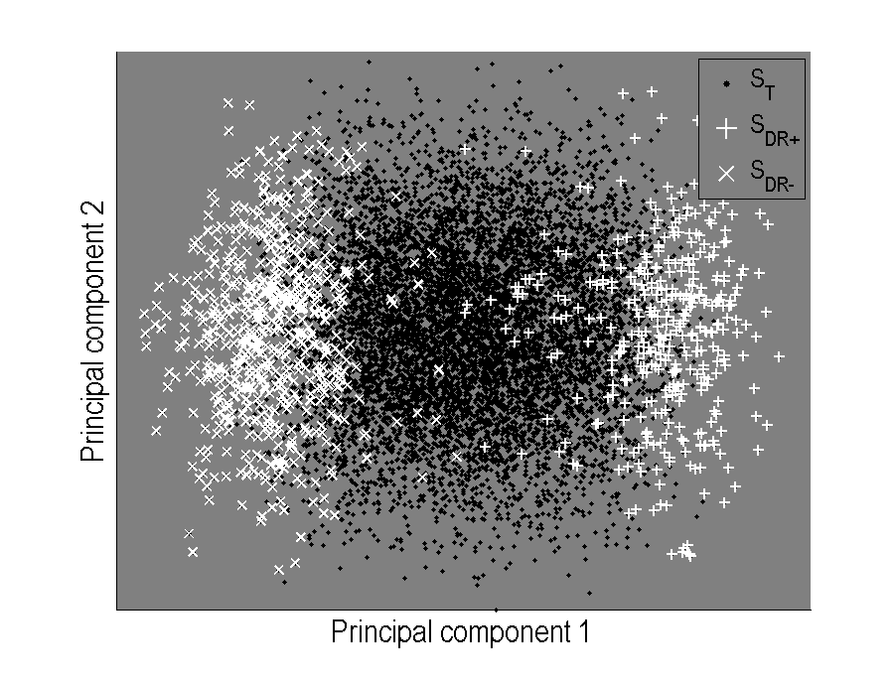
a)
b)
9
c)
d)
SL
SL
LL
LL
Notes:
Negative spikes (Sep30_c2)
Inhibitory response (Sep20_c2)

Slide 9
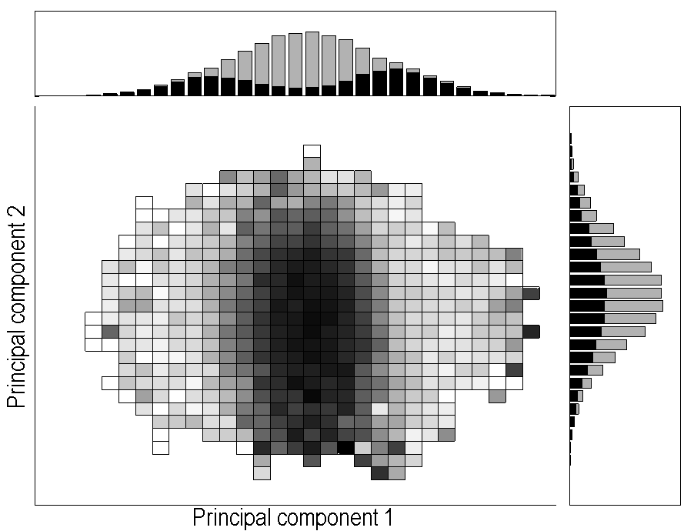
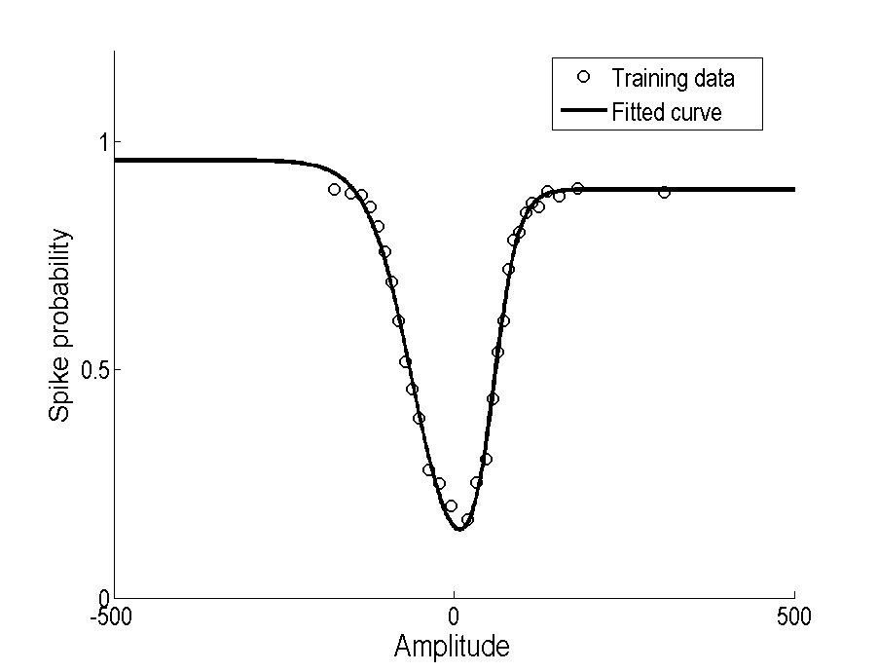
a)
b)

Slide 10
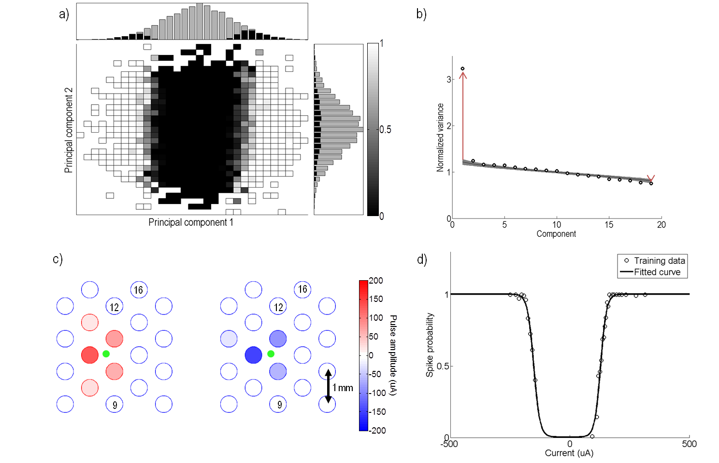
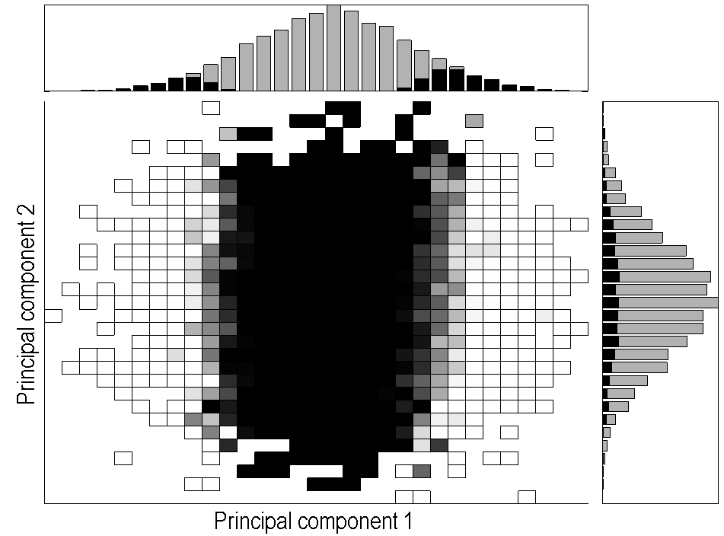
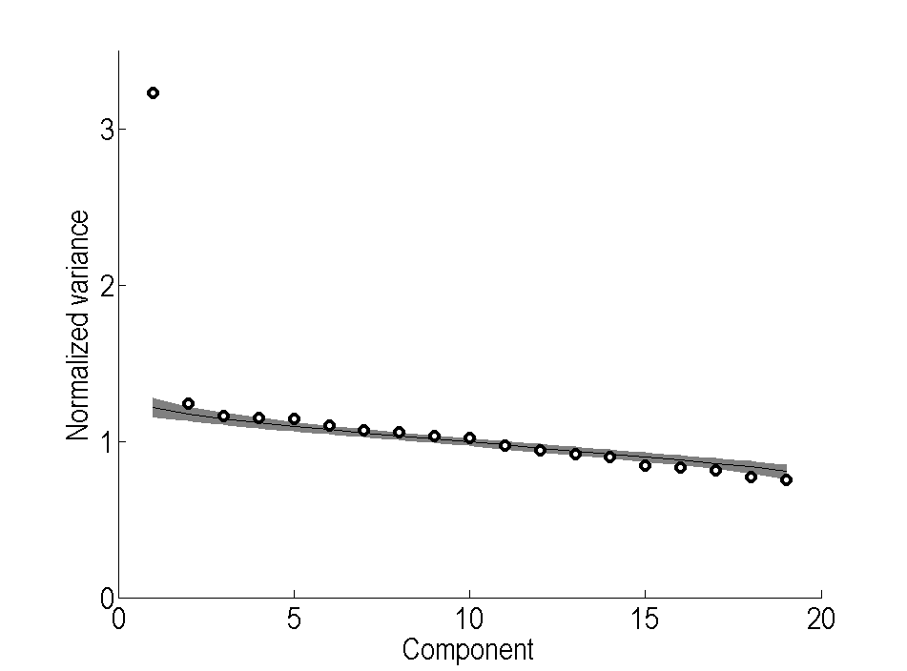
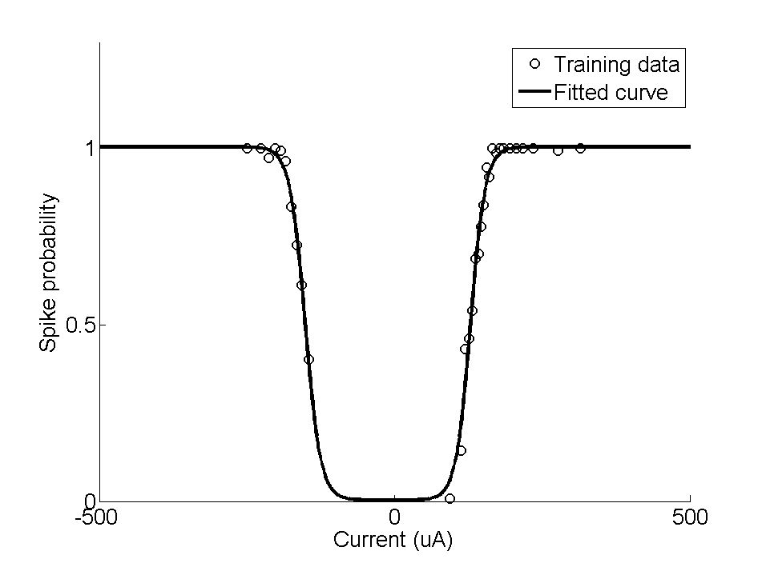
a)
b)
c)
d)
16
16
12
12
1 mm
9
9
Notes:
Single cell example: Sept 20 c1

Slide 11
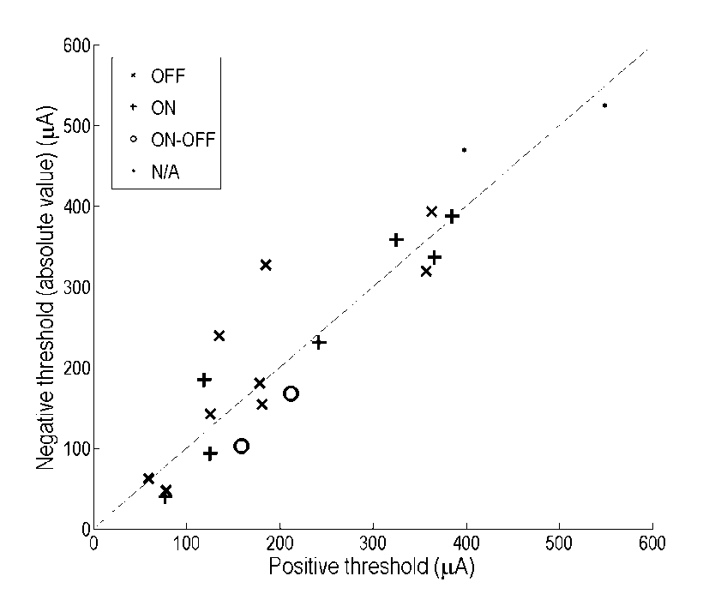
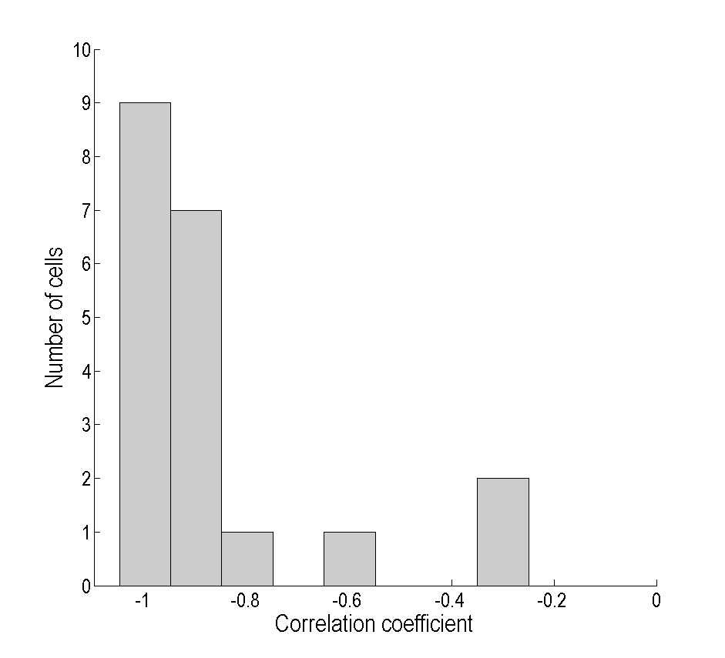
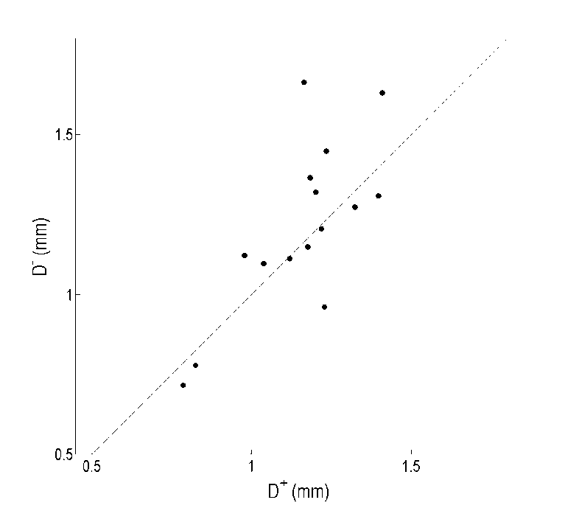
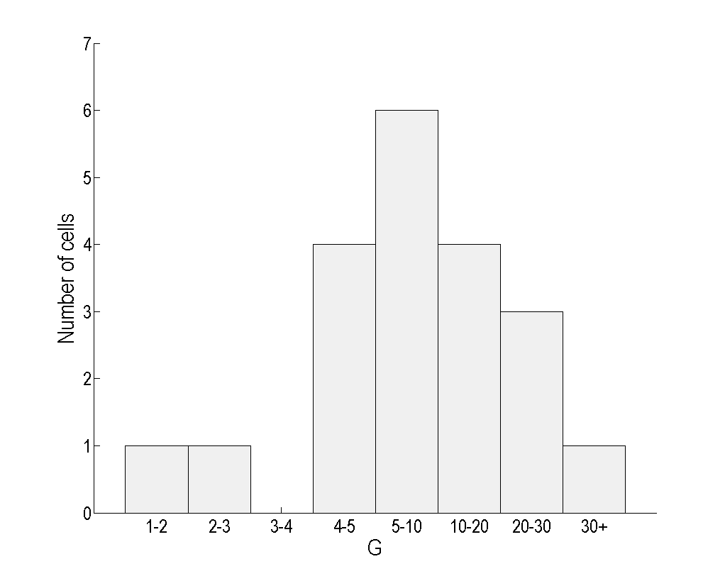
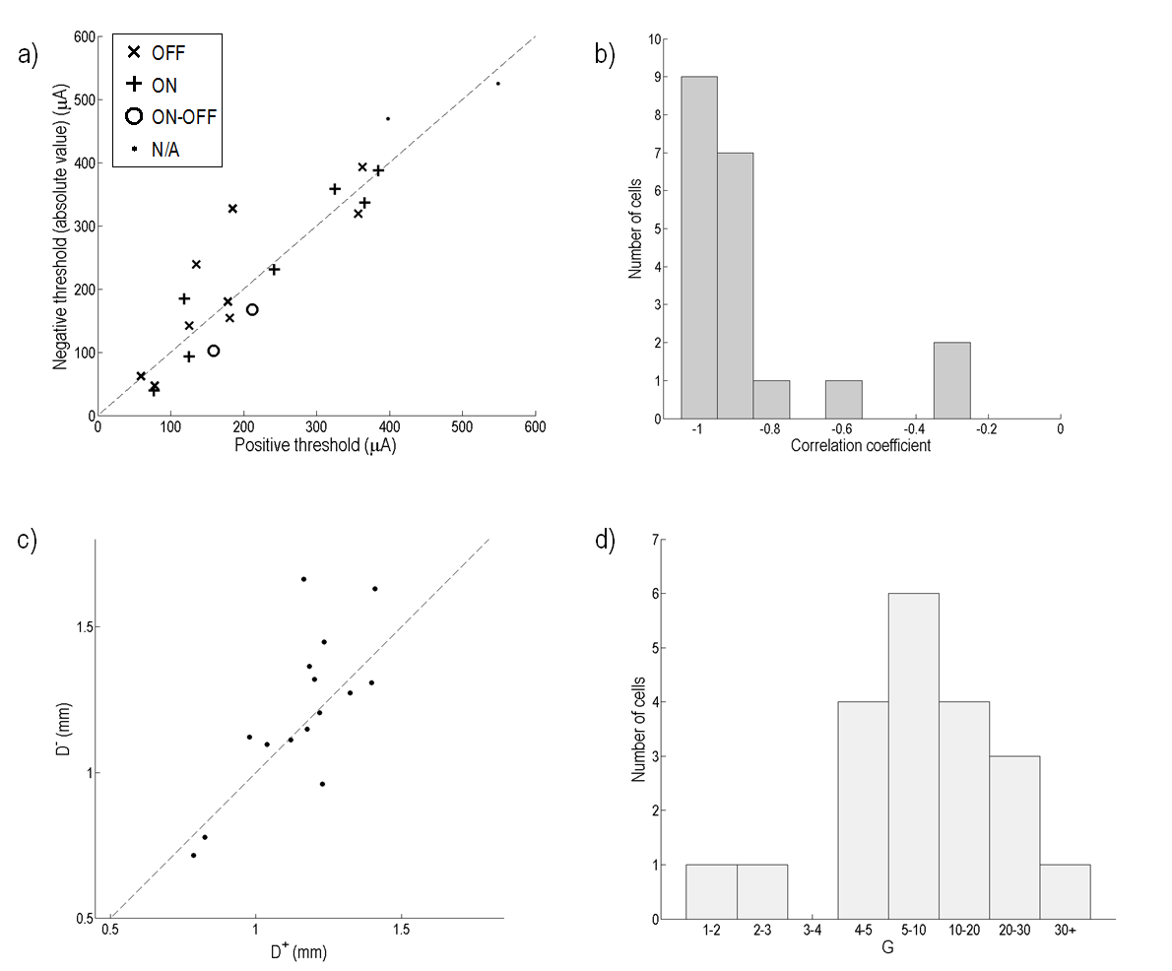
a)
b)
c)
d)
Notes:
Population

Slide 12
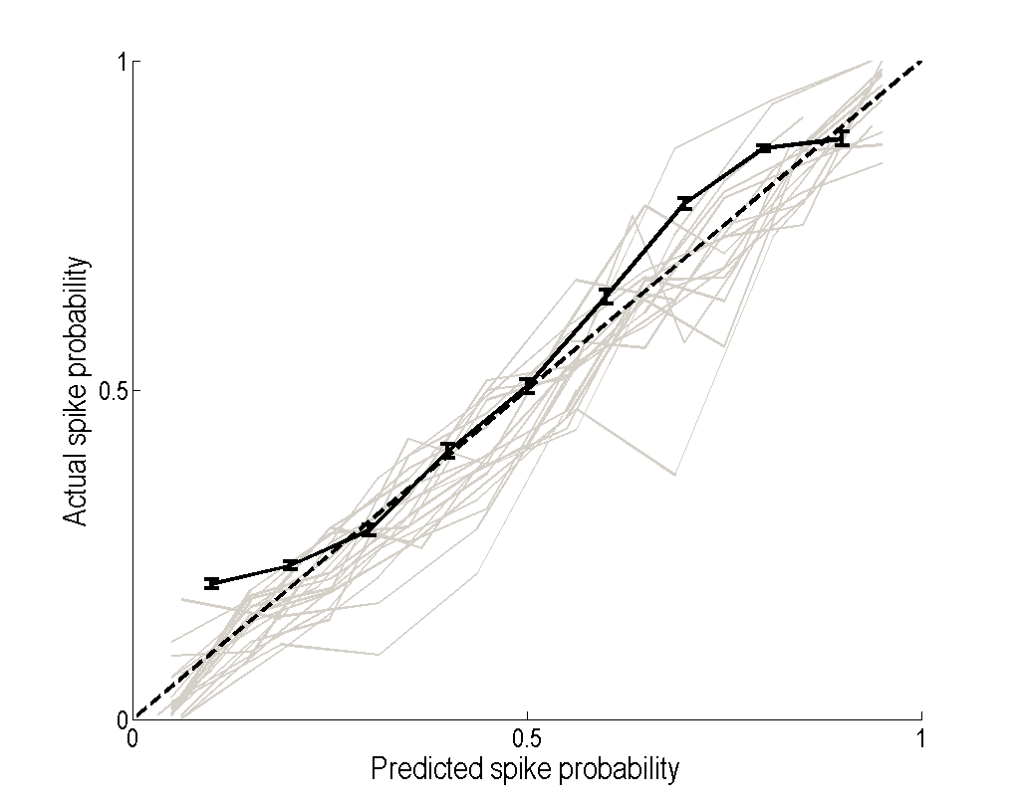
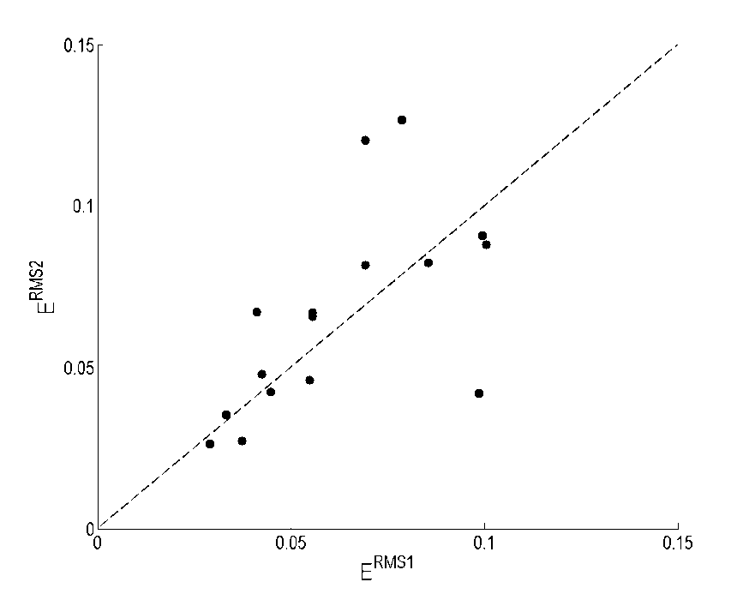
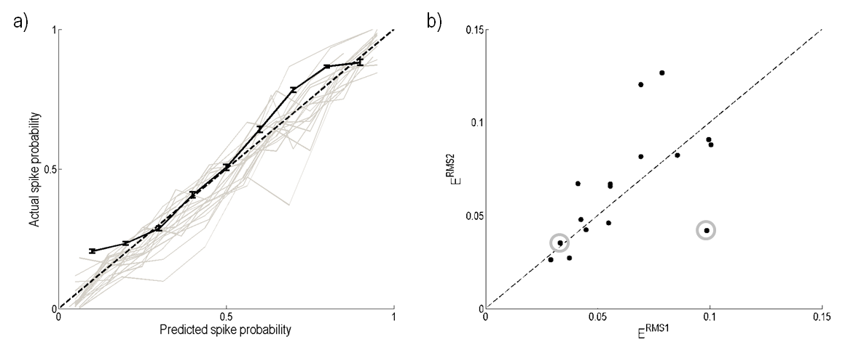
a)
b)
Notes:
Validation

Slide 13
a)
b)
c)
d)

Slide 14
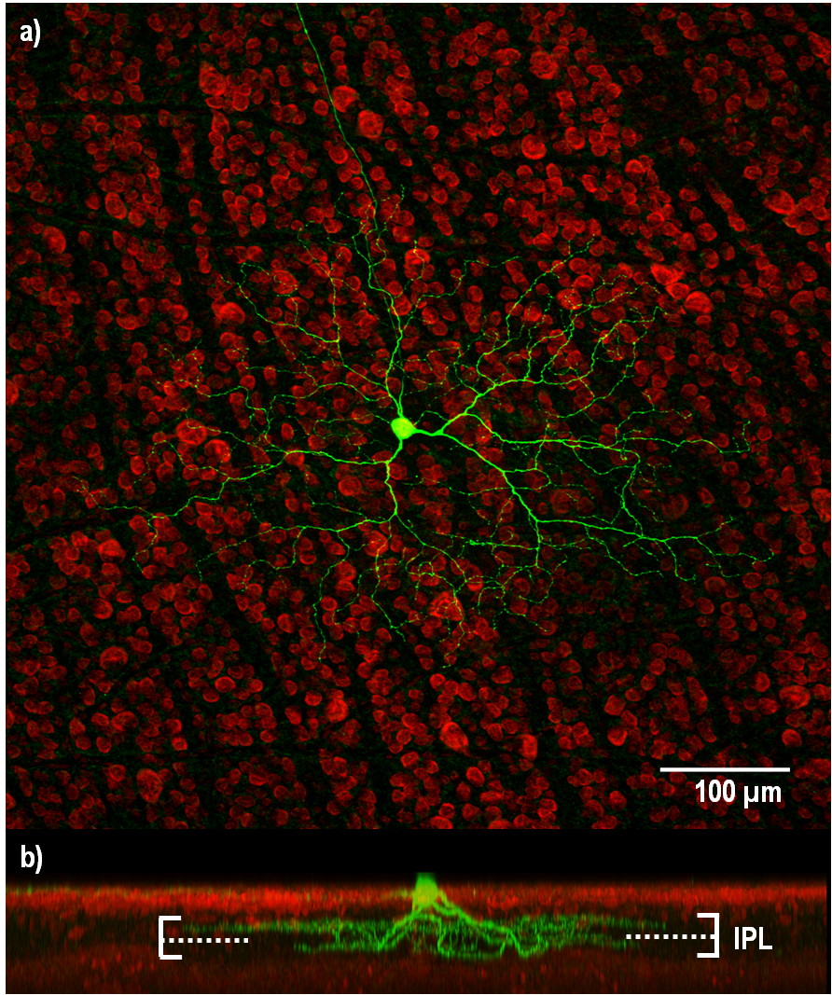
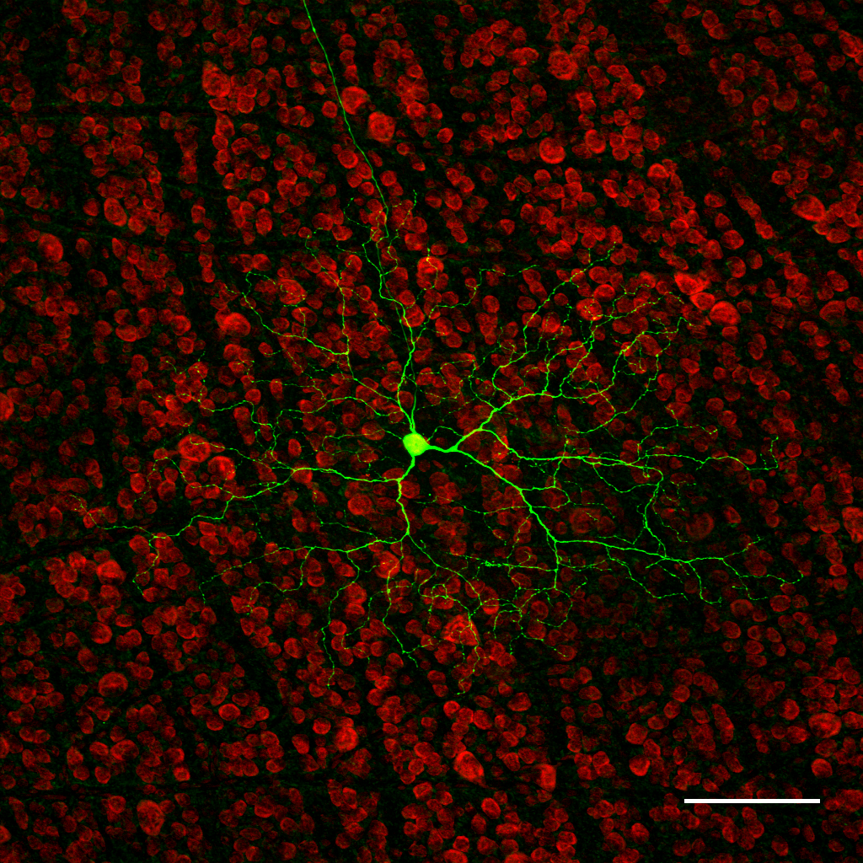
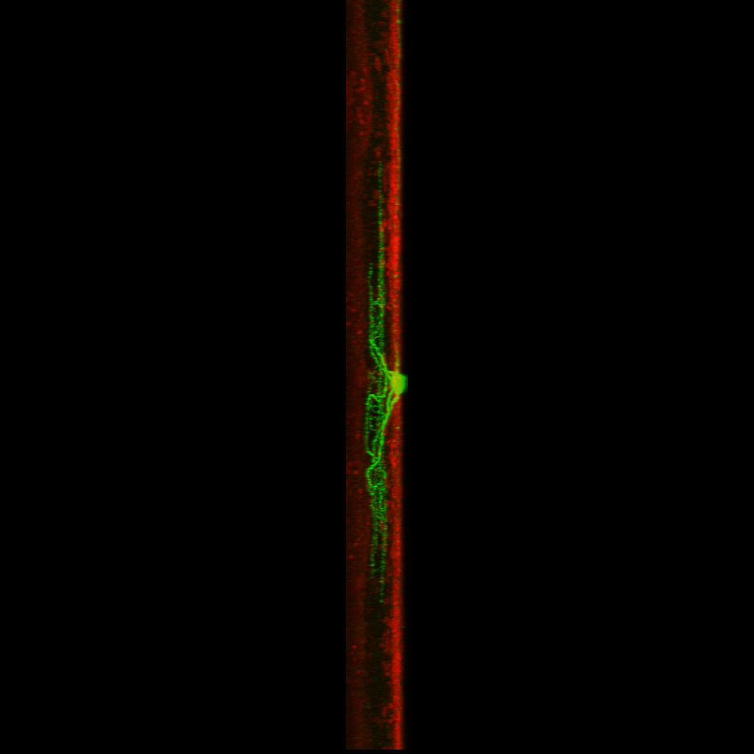
a)
100 µm
b)
IPL

Slide 15
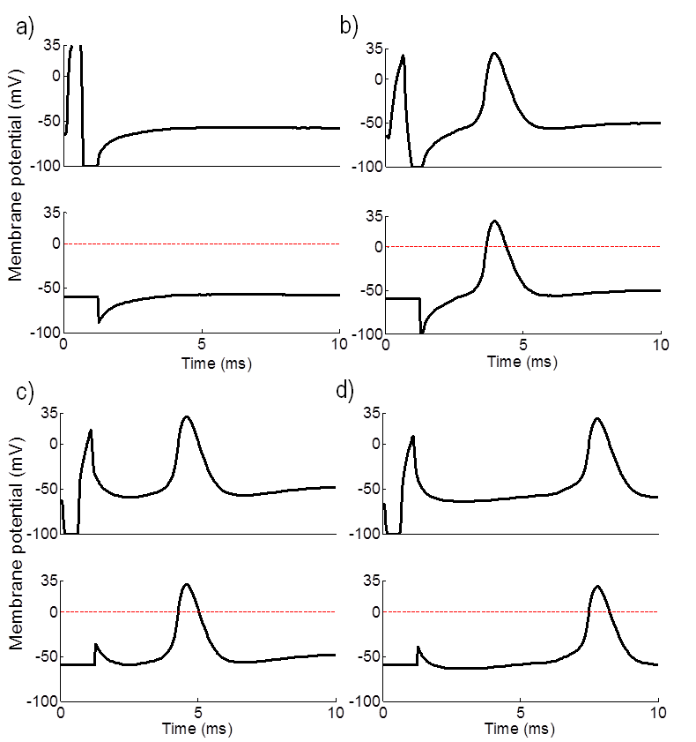
a)
b)
c)

Slide 16
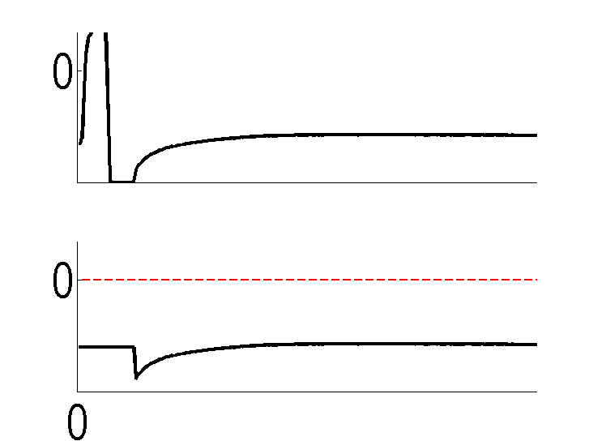
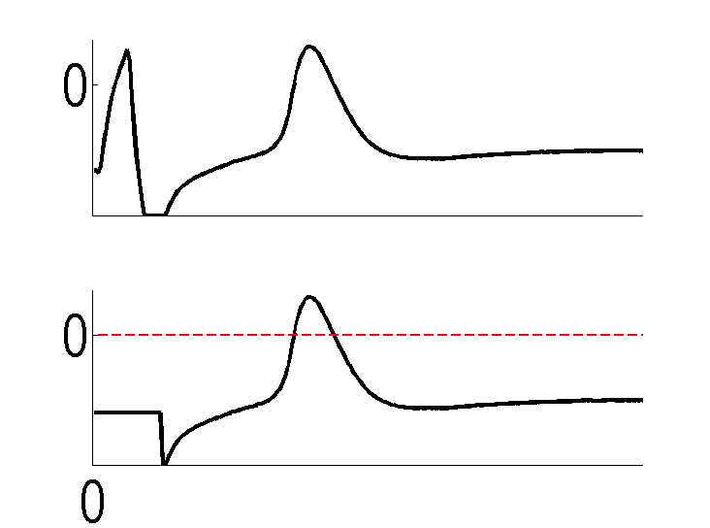
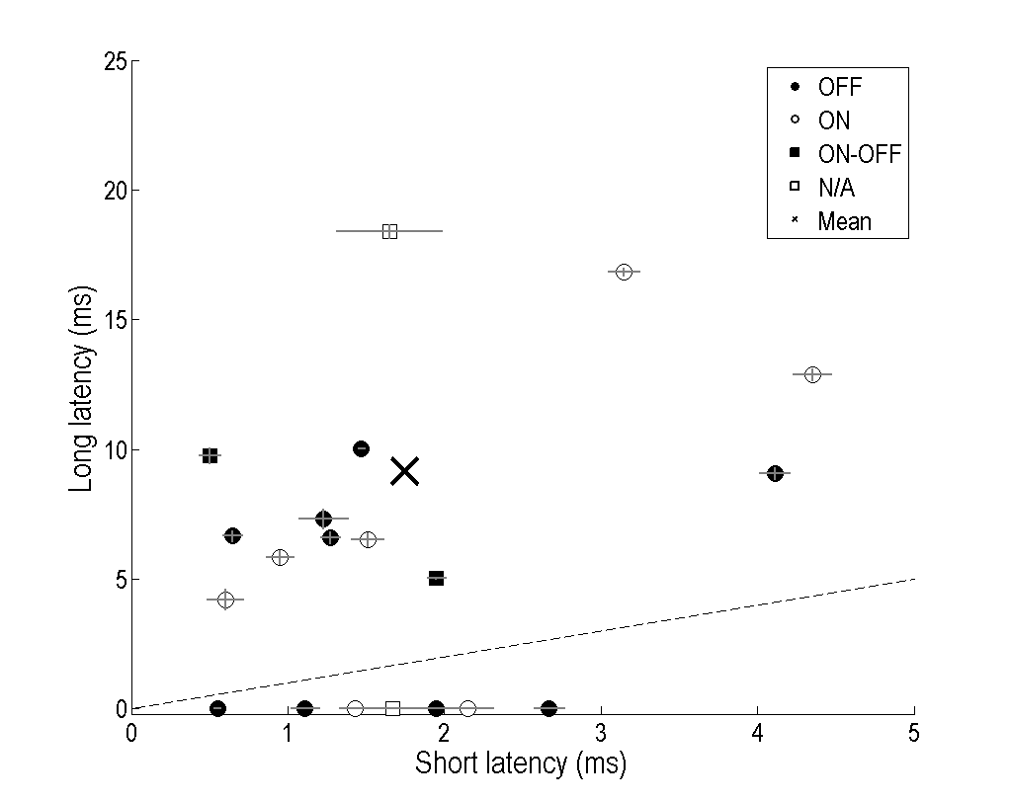
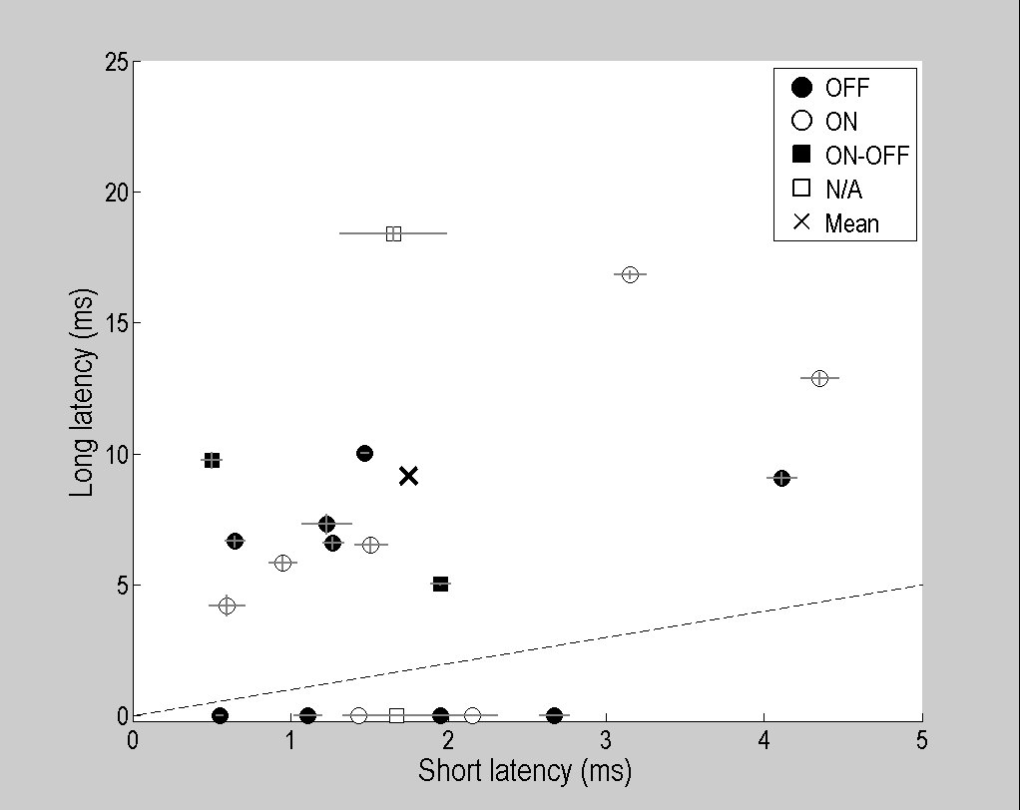
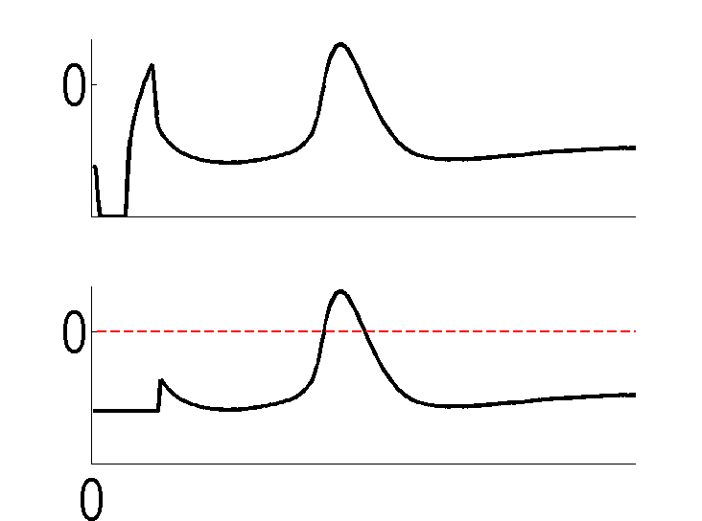
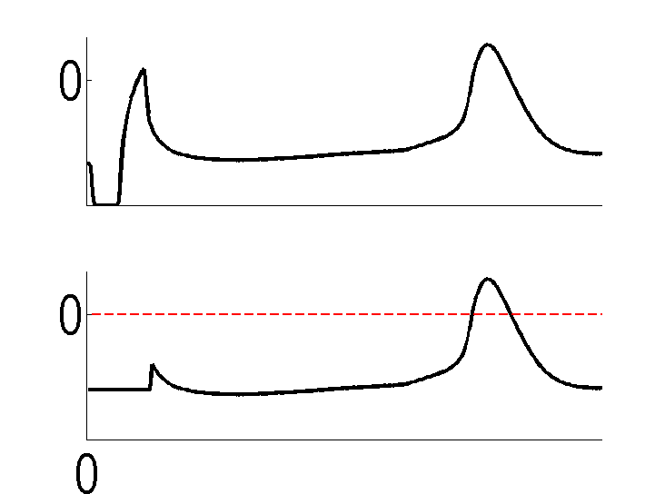
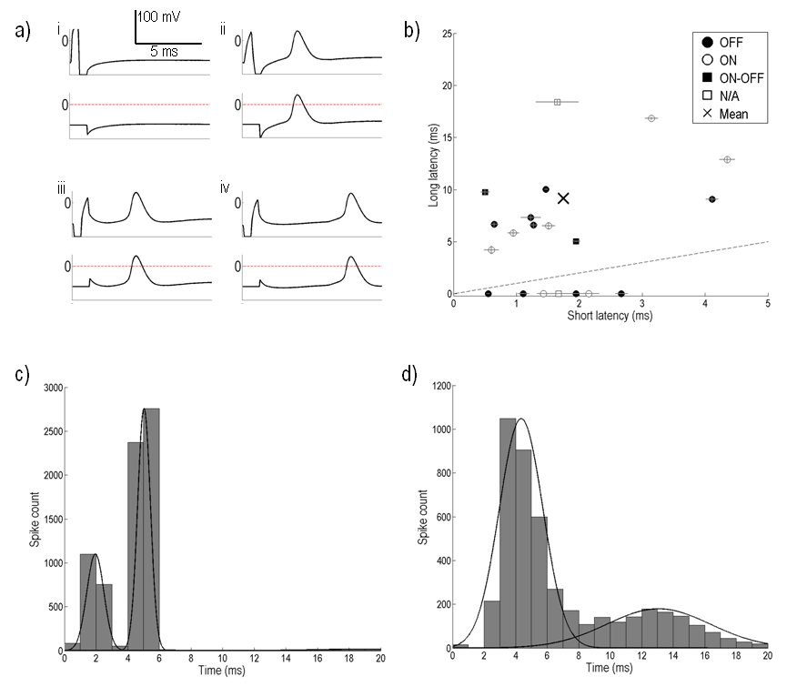
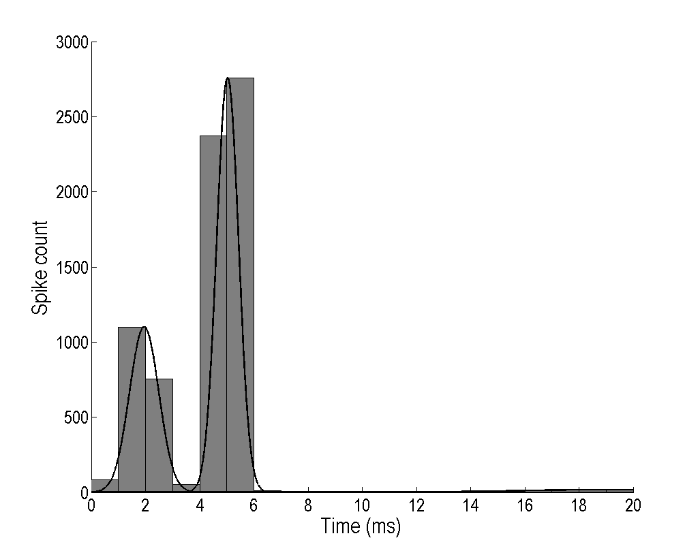
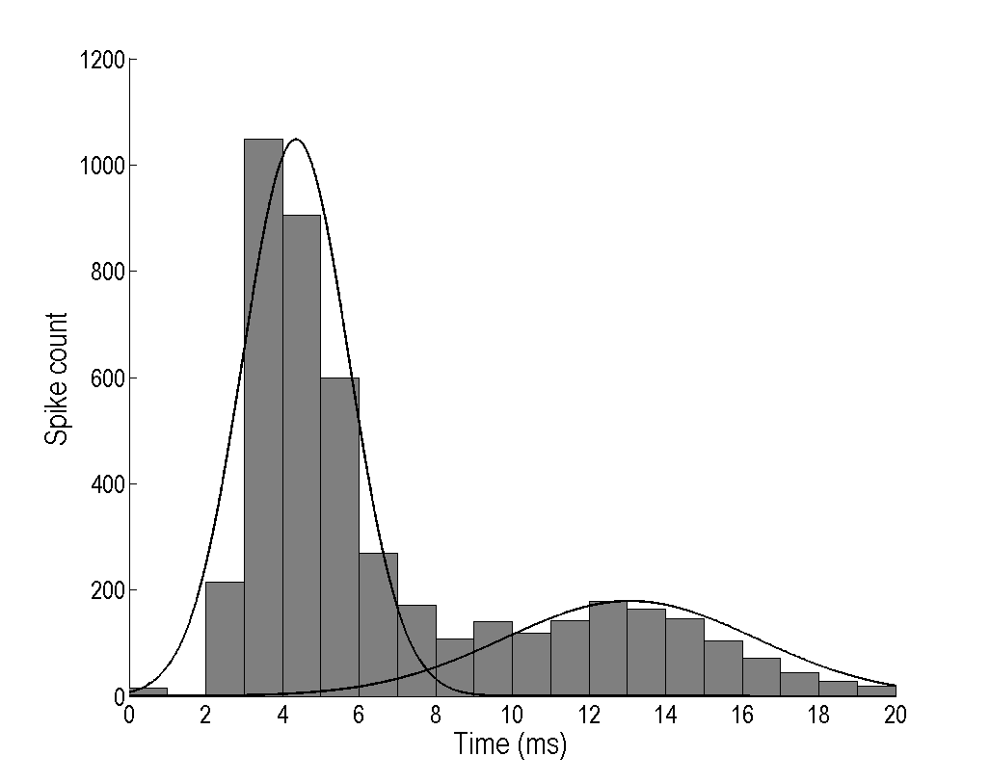
a)
i
100 mV
ii
b)
5 ms
iii
iv
c)
d)

Slide 17
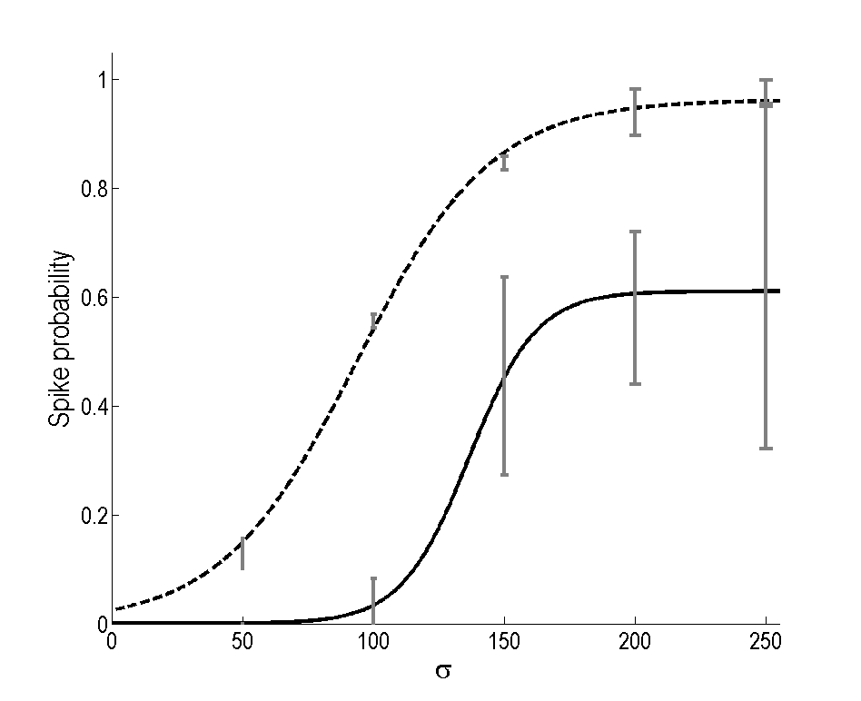
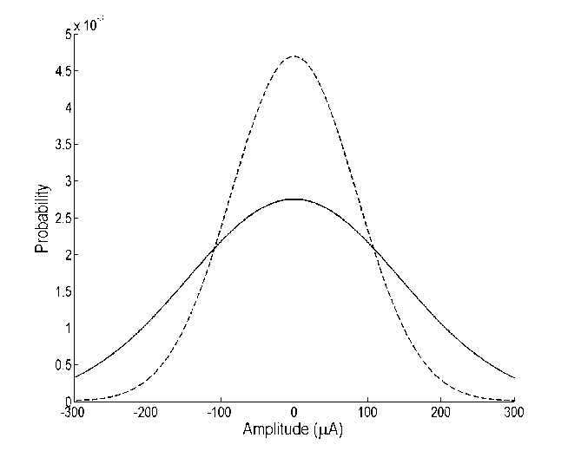
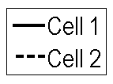
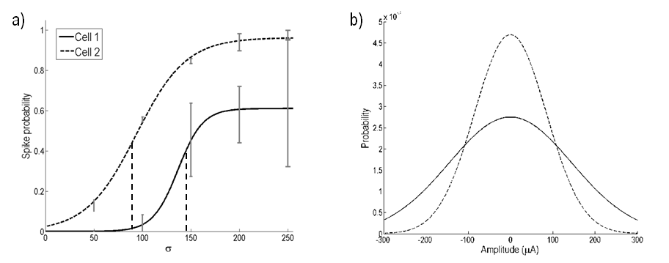
a)
b)
Notes:
C1: sep 30 c2
C2 sep 20 c2

Slide 18
Notes:
2014Sept08_C2
Bistrat

Slide 19
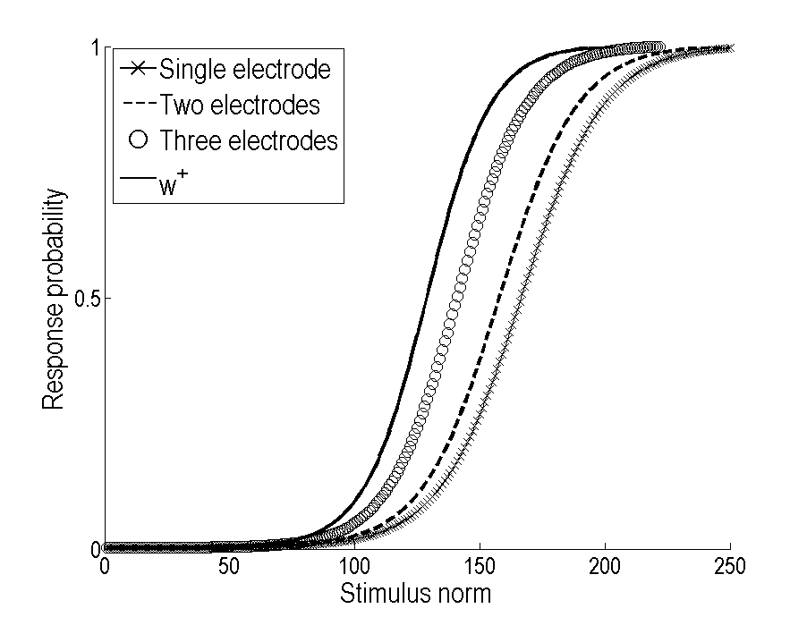
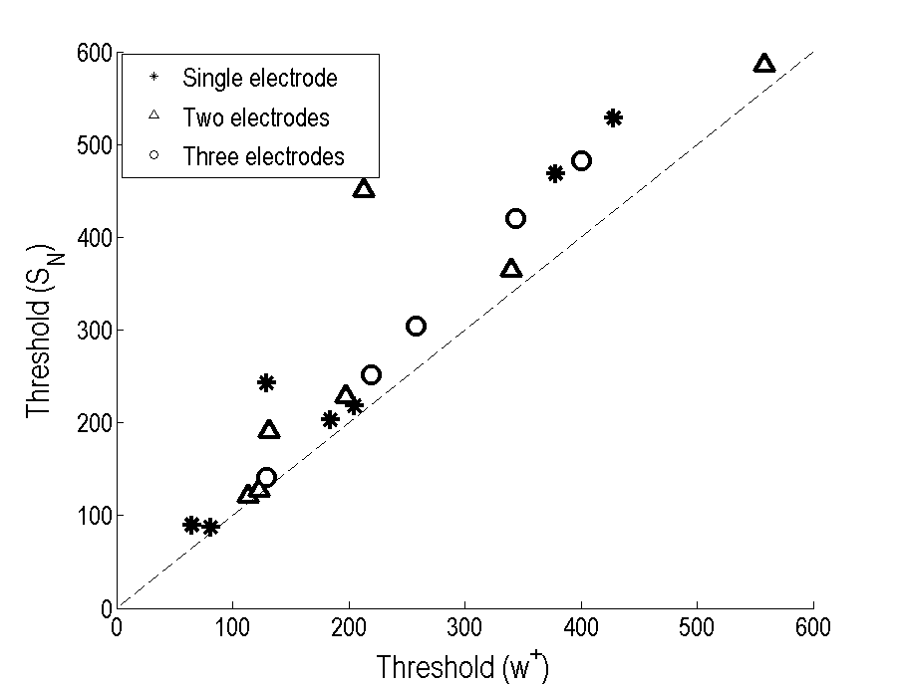
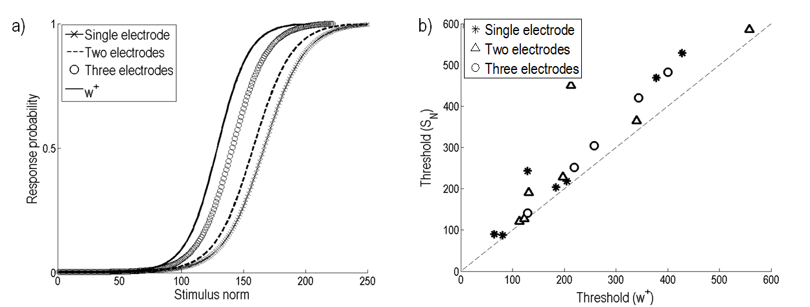
a)
b)

Slide 20
Notes:
2014Sept08_C2
Bistrat

Slide 21
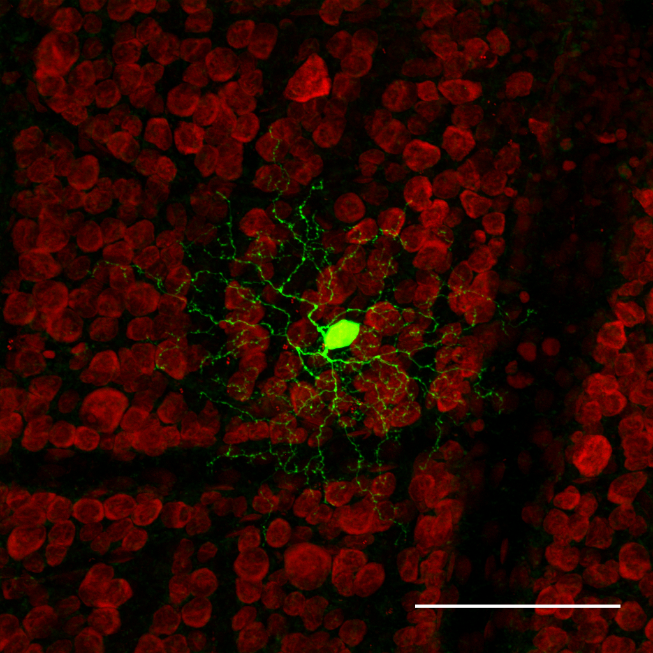
Notes:
2014Sept10_C2
ON

Slide 22
Notes:
2014Sept01_c46
ON

Slide 23
Notes:
2014Sept30_c2
ON

Slide 24
Notes:
2014May07
_c2
ON

Slide 25
Notes:
2014Sept01_c1
ON

Slide 26
Notes:
2014Sept04_c2
OFF

Slide 27
Notes:
2014Sept30_c1
OFF

Slide 28
Notes:
2014Sept17_c3
OFF

Slide 29
Notes:
2014Sept17_c3
OFF

